Slide 1
FISG CGI Payments IP 101
CGI All Payments

Slide 2
Background & Objectives
Background
Objectives
Some of the Members of Payments group unaware of the other IPs
To enable members to assimilate the basics of domain
To empower members
To be able to relate domain and the software being developed
To be able to appreciate the business need of the IP being worked upon
To enable members to assimilate the functional and technical aspects of other IPs within the Payments group
To be able to relate to the overall payments domain big picture
To be able to appreciate the business need of the IP being worked upon
To enable members to be able to work across multiple products in same domain

Slide 3
Agenda
1
Overview of CGI in Banking
2
CGI APS Functional Architecture
3
CGI APS Roadmap
4
CGI APS Competitor position
5
CGI APS Deployment – Case Study
6
CGI APS Technical Architecture

Slide 4
Overview of CGI in Banking

Slide 5
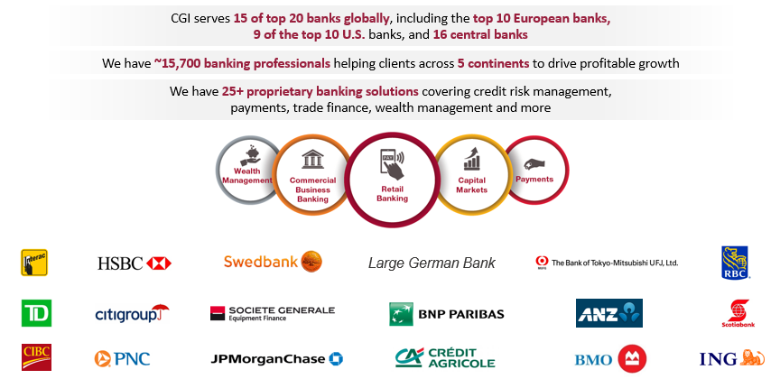
CGI in Banking

Slide 6

CGI is a company of firsts in the payments industry
1973
1984
1994
2001
2008
2015
2016
2018
Designed the SWIFT network for international transfers
Developed and installed the
first BESS wire payments platform
Developed
HotScan in response to U.S. requirement for sanctions screening through OFAC
Created functional specifications and built the bank interfaces for the CLS platform
Developed the CGI All Payments next generation payment hub
Developed SEPA Credit Transfer interface and performed industry- wide testing
Applied real- time payments capabilities to CGI All Payments
Introduced
CGI All Payments Ripple connector
Re-architected and built CGI All Payments for the cloud
Delivered real-time payments capability in partnership with The Clearing House

Slide 7














CGI has driven payments innovation for decades
2007: The EPC devise SEPA schemes
We work with EPC to refine the schemes & produce a SEPA Test Framework
2009: New liquidity regulations from the UK FSA
We educate on the impacts and ensure our clients comply
CGI All Payments in the cloud
SEPA Instant Payments
PSD2 Open Banking API Store
Digital Challenger Bank
1994: USA imposes sanctions checking through OFAC
We develop HotScan
Shortlisted by PC to
Participate in the procurement
of Lynx, Canada core clearing
& settlement system
1969
1983
1996
1998
2001
1994
2005
2006
2007
2008
2009
2012
2013
1992
2014
2016
2017
2016
2018
2019
2020
1969: creation of SWIFT
We review the design and develop SWIFT interface solutions for clients
2013: Payments Council
CGI successfully launch the industry wide account switching programme and implementation of the same scheme at multiple UK banks
1996: CHAPS goes ‘Real Time’
We build the new RTGS service
2005/6: CLS develop Strategic Initiatives programme for CLS
We develop CLS SI new framework and new products
Real-Time Payments & ISO20022
SEPA
US faster payments
SEPA
SEPA
SEPA
SWIFT gpi
1983/4: CHAPS
We design and build the new CHAPS system
2005/8: UK banks design Faster Payments Service in response to Cruickshank report
We support the APACS programme and roll-out
2009: SEPA Direct Debit is launched
We help achieve readiness with SDD, mandate management and SDD B2B scheme
SEPA Inst CT
We work with
EBA and European
banks to provide
a new solution
for SEPA Inst CT
Alternative Networks,
MC API,
SWIFT DLT
1998: Ireland’s new RTGS infrastructure
We build a Real Time Gross Settlement (RTGS) for Ireland, - now sold to 18 countries
UK Mobile Payments Service launch
We work with UK banks to design, test and manage Paym
2008: SEPA Credit Transfer is launched
We help our clients get ready for launch with working SCT solutions
2012: SEPA as a service
We create a hosted platform to offer Mandate Management services to banks and corporates
2000/1: FX banks design CLS
We support the design and development of the CLS interface for member banks [sold to 12 banks

Slide 8
CGI’s Footprint in Payments
40% of global foreign exchange (Fx) settlement volume processed by CGI
20% of SWIFT message volume transferred by our financial software solutions
35% of US wire transaction volume handled by CGI
70% of the world’s top financial institutions have partnered with CGI, including 8 of the top 10 global banks
CGI has designed and implemented market infrastructures and central bank payment systems for more than 40 countries
CGI All Payments is currently deployed, or is in the process of being deployed, with major financial institutions in North America, Europe, and Asia

Slide 9
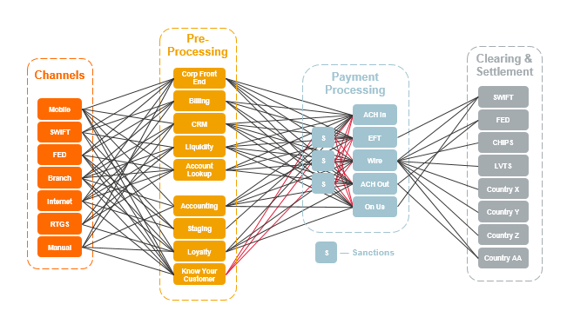
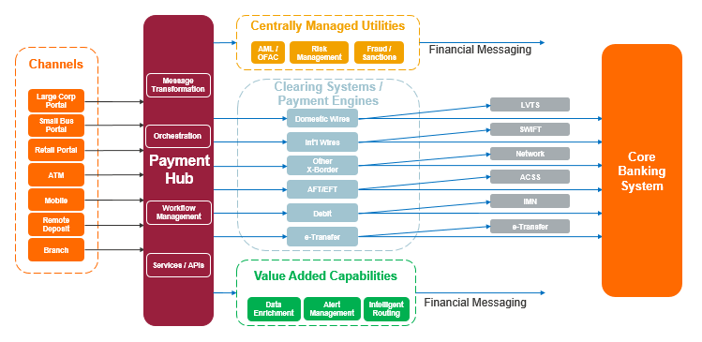
Payment modernization challenges
Technical challenges
Ageing infrastructure
Restrictive database structures
Legacy applications
Redundant integrations
Real-time scheme SLAs
Business challenges
Increasing payment volumes
Operational silos
New and increasingly complex regulation
Changing client expectations
Tailored services
Faster and cheaper
Fintech disruptors offering new services
Real-time payments/Faster payments
How to get from here
to there

Slide 10


CGI All Payments – the Answer
Experience the commitment®
High Value Batch Processing
Real-Time Cross-Border
CGI All Payments is how financial institutions can modernize their customers’ payments experience
Target markets – FIs
Tier 1 - Large global financial institutions such as J.P. Morgan, Goldman Sachs, Citi Group, Bank of America.
Tier 2 – Large to medium sized financial Institutions with a global presence such as Barclays, Credit Suisse, Canadian Imperial Bank of Commerce (CIBC) - Existing clients include Deutsche Bank and National Bank of Canada (NBC).
Tier 3 – National or regional financial institutions such as credit unions, savings and loans, and building societies that may also use third-party providers for their payment systems

Slide 11
CGI All Payments
an intelligent and flexible payment hub that meets today’s challenges and helps achieve banks’ long-term payments vision
Global
Multi-entity, multi-language, and workload management capabilities for complex organizational structures
Ability to quickly bring new products to market and enter new territories
Flexible
Support for the full spectrum of payment services, from mass payments to high care.
Support for existing and future payment types.
Flexibility to respond to current market drivers with real-time payments
Efficient
High scalability and the ability to run separate services concurrently without performance degradation
High configurability to achieve high levels of responsiveness, autonomy and reliability
Cost effective
Cost savings from consolidating operations and payments processing, replacing inefficient legacy systems, and reducing manual processing while improving straight-through processing
Compliance and Standards
Integrated Compliance Management – AML & Fraud detection
ISO20022 native support.

Slide 12
CGI APS – Functional Architecturet Overview & Features

Slide 13








What does CGI All Payments do?
Bank Channels
Bank Back Office
CGI All Payments
Other Bank Systems
Validations
&
Core Banking
Customer Authentication
& Authorisation
Enrichment
Method of Payment
,
Compliance
/
Filtering
Routing Determination
Capture Payment
/
Batch
Billing
&
Invoicing
Warehousing
Account Balance
General Ledger
Check
,
Limits
...
MIS
/
DWH
Credit
/
Debit Posting
.
Clearing
&
Settlement
Customer Notifications
Customer Reporting
&
Advices

Slide 14
CGI All Payments Overview
Integration Framework
Financial Messaging
Files In
Files Out
Interface Feedback
Services / API
Common Channel Services
Transaction Services
Transaction Initiation (internal)
Dashboards
Liquidity Manager
STE Operations
Check
Manual Capture
Recurring Transactions
Transactions & Batches
Payment Templates
Processing Services
Parties Management
Validate & Enrich
Business Dates
Matching
Prioritization
Warehousing
Auto Repair
External Authorization Check
Regulatory Filtering
Limits
Fees and Billing
Distribution
Notifications
Accounting
Reconciliation
FX
Suspicious Payment
Float & Profit Sharing
Tax
Routing & Clearing Partners
Customers & Accounts
Permitted Creditors
Mandates
Core Processing
Real-Time Processing
Bulk Processing
STE Processing
Scheduler
Static Data
Multi-Entity
Internationalization
Partitioning
Archive & Delete
User Security
Application Security
Audit Log & Alerts
Reporting
Printing
UI Framework
Notes:
Highlights

Slide 15
System context and Logical flows
Payment Initiation e.g. bank’s Front-End systems and internal systems (“host”)
Client Reporting Engine bank’s reporting system(s)
Hotscan AML compliance check – regulatory scan
Centaur fraud detection, bank’s KYC check
CSM e.g. Clearing and Settlement mechanisms, e.g. NACHA, FEDWire,…
Correspondents Correspondent banking over SWIFT
Core Back Office (CBS) back-end systems holding Customer & Accounts, ledgers, billing systems and rate lists
Manual input e.g. BESS APS channels which are not directly integrated to a counterpart system
Introduction and system context

Slide 16
CGI APS – Roadmap

Slide 17
CGI All Payments 3-5 Year Roadmap (Targets – For Discussion Only)
Broaden connectivity, standards, message formats and expand global reach
2019
U.S. (Non-ISO)
Canadian ISO
2020
Global SWIFT
and Nordics Payment Initiatives)
2021
ISO North America
ISO Intl (Limited)
2022
Global Liquidity Engine
US RTP Enhancements
2023
Asia/Australia Rails
Fed/CHIPS/NACHA
SWIFT Payment types/ localization
SWIFT gpi enhancements
Europe SEPA Instant
SEPA refresh
LVTS
UI refresh
Analytics & BI
Regulatory & Maintenance Updates
Client-specific Enhancements
Global SWIFT (complete intl SWIFT Services)
UK - NPA
Nordics - P27
Canada – LYNX (replacement LVTS)
Canada - AFS
, Regulatory & Maintenance Updates
Client-specific Enhancements
ISO Migration for Lynx
ISO Migration for FED & Chips
ISO Migration for SWIFT - MT1, 2 & 900’s
Payment types/ localization
RMA
Regulatory & Maintenance Updates
Client-specific Enhancements
Originators/DD for Real Time Payments
Gateway FM Capabilities
Global Liquidity Module
Regulatory & Maintenance Updates
Client-specific Enhancements
Asia/Australia Rails
Regulatory & Maintenance Updates
Client-specific Enhancements

Slide 18
CGI APS – Competitor analysis

Slide 19
CGI APS – Competitive position
Knowing the competition we are up against is a crucial element in every sales process. Every (potential) customer will evaluate how we stack up against the competition.
Our competitors:
Finastra (formerly Fundtech) – Global PAYplus
ACI worldwide – ACI Universal Payments
Fiserv (formerly Dovetail) – Enterprise Payments Platform
FIS Global (formerly Clear2Pay) – Enterprise payments
Some of our competitors have:
Large installed client base (Fiserv, ACI)
High value revenue stream through maintenance (ACI, Fiserv)
Reasonable level of private funding (Fiserv)
Better pricing flexibility (FIS Global)
Attractiveness of a single payment architecture (FIS Global, Fiserv)

Slide 20
CGI APS Deployment – Case study

Slide 21

Payment Hub – National Bank of Canada
What the bank needed
Replacement of legacy platform reaching end of life
Implement a modern payment services hub
Support “like-for-like” functionalities for SWIFT
Provide opportunities for greater process automation and streamlining
Deploy foundational framework for payment hub incl. API, Centralized tools and capabilities
Phased approach to delivery but Agile to accommodate rapid changes
Multi-cloud deployment – to go-live in a couple of months
Increased levels of automation and STP
Implementation of workflow and rules based processing to improve customer responsiveness
Our Answer
Fully automated build, deployment, testing including Continuous Integration and tests
Different business flows covering inward, outward, cheque advises, non-financial messages
Functional modules flexibility – processing steps to cater to different functional requirements
Integration patterns – KAFKA, file based, REST APIs
Support for future initiatives by Paiments Canada – LYNX (replacement of LVTS)
Release 2 and 3 to focus on AFT, EDI and Bulk payments
Value Proposition

Slide 22
PROJECT SCOPE
Release 1 Wires
Release 1A
Implement a more modern technology platform (CGI APS):
Support “like-for-like” functionalities with LVTS and SWIFT
Enable some additional message types (e.g., 9xx) and notification functionalities
Provide opportunities for greater process automations and streamlining
Deploy foundational framework for payment hub incl. APIs, centralized tools and capabilities, etc.
Release 1B
Meet Payments Canada’s requirements for Lynx:
New RTGS risk model, collateralization requirement, and urgent/non-urgent payment items
SWIFT MX messaging set (i.e. ISO 20022) enabled for Lynx Phase 2
LSMs, queue management, notification capabilities, and interfaces
Enable capabilities to support future functionalities (e.g., SWIFT gpi, SWIFT for Corporates, Ripple)
Initial focus is the successful delivery of Release 1 – which forms the cornerstone of the Payment Hub project
Release 2 AFT
Meet Payments Canada AFT requirements (e.g. new serviceability codes, fund availability)
Support Payments Canada defined ISO 20022 messages (e.g., PAIN/CAMT) and related rules
Support mechanism to allow for retirement of Standard 005
Meet Payments Canada’s requirements for SOE:
New connectivity model
New financial risk framework (e.g., same-day settlement)
New reporting requirements
New participation model (e.g., unbundled exchange from clearing and settlement)
Possibility of centralized exchange model (TBD – under review by Bank of Canada)
Payments Canada has not provided detailed requirements for this phase of the Modernization Program (e.g., scope of SOE, potential sunset of EDI for inter-bank exchange)
Release 3 EDI + Bulk Payments
Support exiting EDI payment and information capabilities in compliance with Canadian standards (H6 & E3)
Versions 3010, 3030 & 4010; in-house EDI file format (CPE)
Acknowledgement cycle management (813 / 820 / 824 / 824 neg / 828 / 997 / 824)
Notes:
DAVID

Slide 23
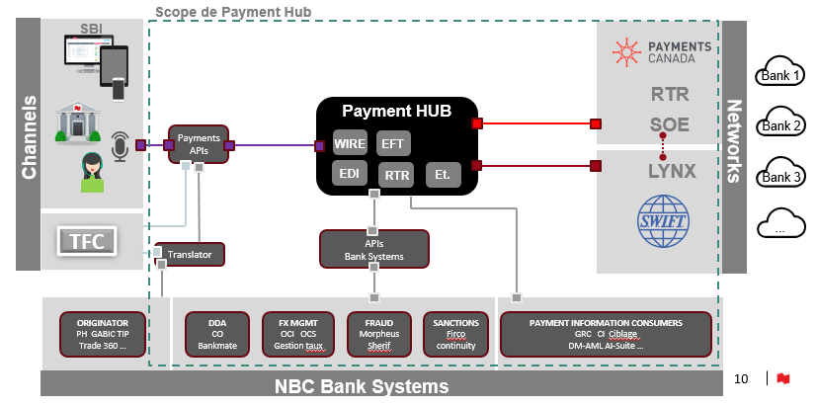
NBC – Target state

Slide 24
CGI APS – Technical Architecture Presented by – Subbanarasa Puttana Overview & Features

Slide 25
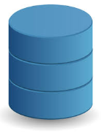
Architecture Overview
Payment Feeders
Browser Client
Identity Provider
Clearing
All Payments
Downstream systems
SWIFT
REST API
AML / OFAC
LVTS
Services
Fraud Analytics
MQ, REST API, SOAP,
SFTP, IBM C:D
MQ, REST API, SOAP,
SFTP, IBM C:D
Workflow Engine
Bulk
Clearing
DDA
Workflow Steps
Real-Time Clearing
Business Rules
FX, etc
Oracle Database
(All Payments)
Cassandra (Cold Storage for In-flight Real-Time Payments)
Confidential

Slide 26
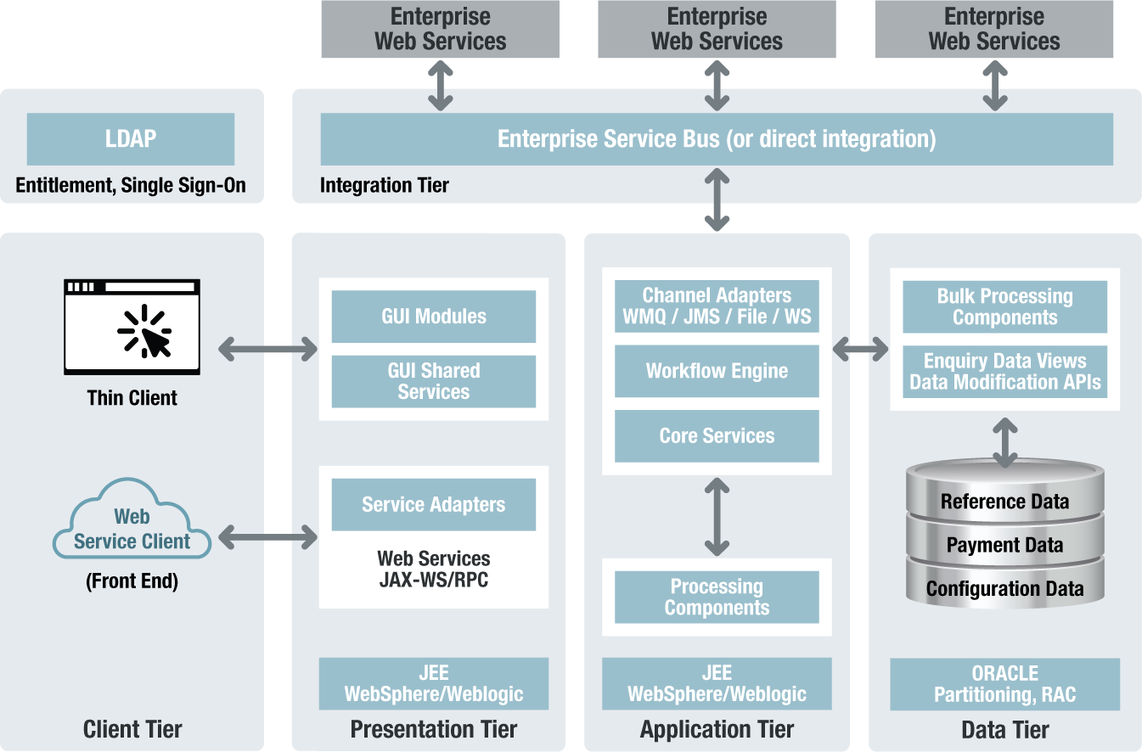
CGI All Payments Tiered Architecture
Workflow
Notes:
CGI All Payments Solution is a multi-tier Java Enterprise Edition (JEE) compliant Application, designed and built upon SOA principles and utilising the power of the Oracle EE Database to support a banks payments processing needs.
Key architectural highlights are:
Use of industry standard and open Middleware and Database infrastructure and software
Flexible deployment of the CGI All Payments Solution logical tiers to one or more physical servers
Flexible deployment across a large variety of hardware and operating systems vendors
Full support for High Availability and Resilience via industry standard Application Clustering and Oracle Database Replication
Payment processing constructed around a CGI All Payments Solution payment specific workflow engine
Integration with a Bank’s existing Enterprise Service Bus and Message Broker to support SOA style initiation and orchestration
Flexible message transformation via the CGI All Payments Solution Channel Handlers and/or alongside transformation via a Bank’s existing ESB
“Out of the box” support for a variety of industry and de-facto industry integration standards for the transmission of payments and files of batch payments:
Web Services (SOAP or REST);
Messaging – Websphere MQ and JMS;
File Transfer – IBM Connect:Direct and sFTP
Integration with a Bank’s User Entitlement and Single Sign-On System using LDAP Services
Data segregation via Oracle Fine Grain Application Control provides secure separation of data across entities
Database partitioning supporting mass data whilst maintaining consistent processing and response times.

Slide 27
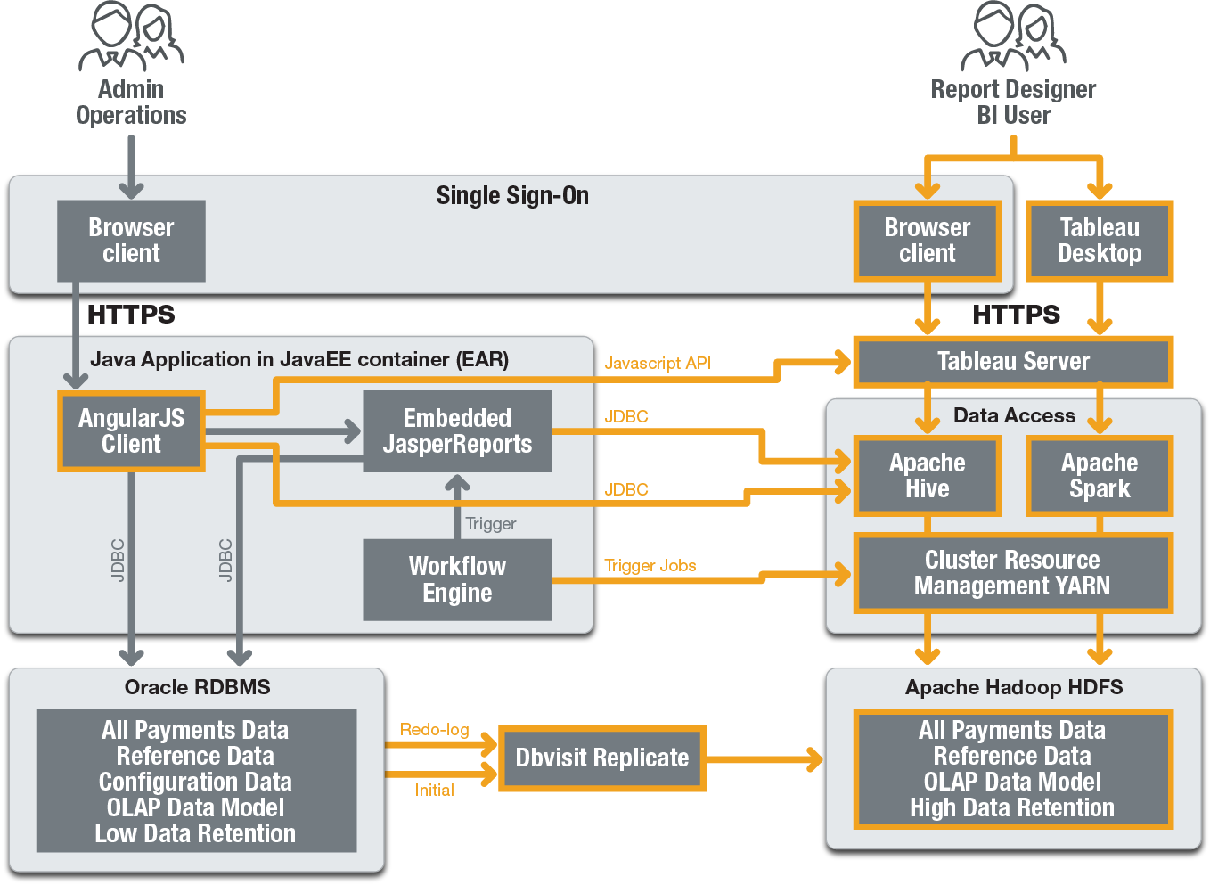
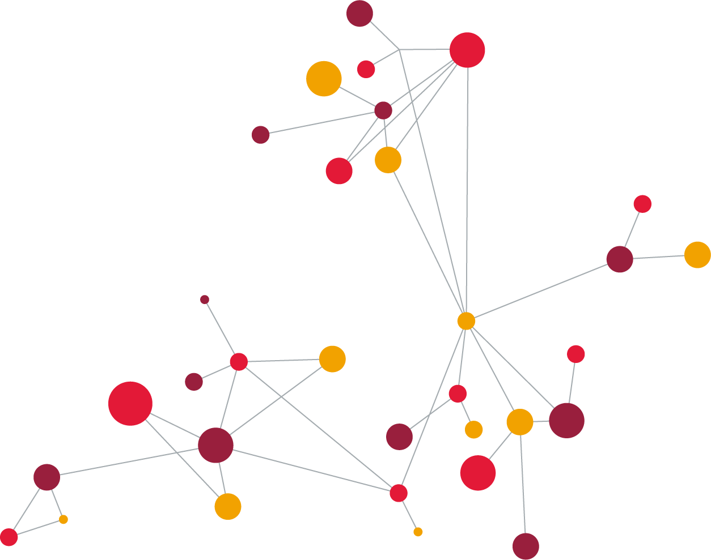
CGI All Payments – Business Intelligence Architecture

Slide 28
High Availability / Disaster Recovery
Azure Secondary Site
Azure Primary Site
AWS Tertiary Site
Architected to multi-cloud
Auto restart using Kubernetes health probes and Kubernetes load balancing / services
Data geo-replication
Landing zone for payment files (inbound & outbound payments)
Synchronous replication of transaction files dropped to CGI landing zone by Bank to guarantee data consistency between sites
Asynchronous database geo-replication (Oracle Data Guard) is used to maintain performance
Load Balancer
Load Balancer
Load Balancer
HTTPS MQ over SSL SFTP
HTTPS MQ over SSL SFTP
HTTPS MQ over SSL SFTP
Landing Zone
Synchronous Communication
Landing Zone
Synchronous Communication
App server
(active)
App server
(active)
App server
(standby)
App server
(standby)
App server
(standby)
App server
(standby)
JDBC
Secured Private Network
JDBC
Public Internet
VPN
JDBC
JDBC
JDBC
JDBC
JDBC
JDBC
JDBC
JDBC
JDBC
JDBC
Asynchronous Communication
(Latency 25 ms)
Asynchronous Communication
(Latency 44 ms)
Data Guard (Synchronous)
Data Guard (Synchronous)
Data Guard (Synchronous)
DB server
(active)
DB server
(standby)
DB server
(standby)
DB server
(standby)
DB server
(standby)
DB server
(standby)
Current data
Current data
Archive
Current data
Current data
Archive
Current data
Current data
Archive
Backup
Backup
Backup
Two-Site Delivery Model
Confidential

Slide 29

































Technology Stack – Runtime
Browsers
Monitoring Tools
UI Frameworks
Authentication Provider
Reporting
Deployment & Runtime (Public / Private)
Application Containers
Application Frameworks
Databases
Messaging / Transport / Storage Middleware
Confidential

Slide 30


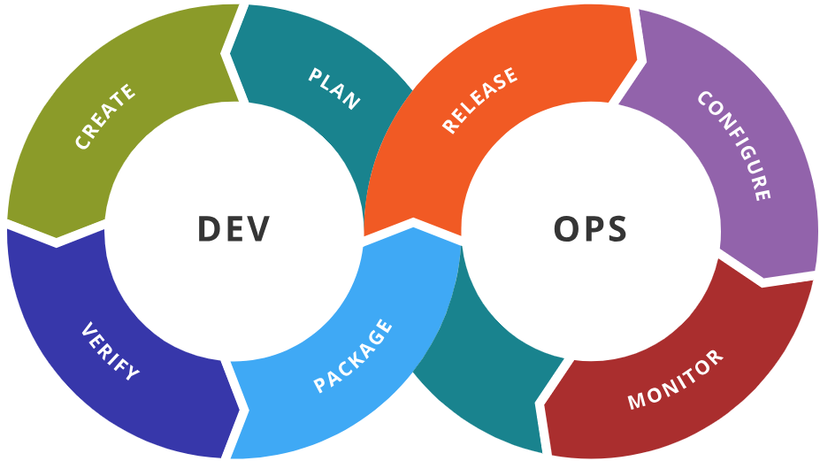






Technology Stack – DevOps
Confidential

Slide 31
Deployment Mechanism
Fully automated deployment
Containerized deployment using Docker + Kubernetes
For all components of the solution (Application Server, Oracle Database, WSO2 Identity Server, Boulder CA, SFTP server, MQ server)
Docker images for stateless deployments
Docker jobs for stateful sets (Oracle Database, Cassandra)
alter schema + data migration scripts
Test automation also runs in Docker including interface simulators (downstream systems)
Confidential

Slide 32
Our commitment to you We approach every engagement with one objective in mind—to help clients succeed.

